Slide 1





Predictability No magic required
Julia Wester
Improvement Coach & Team Manager
learn@leankit.com
@everydaykanban
EverydayKanban.com
Notes:
Hi, I’m Julia Wester and I’m here today to talk about predictability.

Slide 2

Predictable [pri-dik-tuh-buh l]
USUALLY
HORRIBLE!
USUALLY
GREAT!
USUALLY
________!
Adjective
Expected, especially on the basis of previous or known behavior
[good or bad!]

Slide 3

Pulling answers from randomness
How many telephone lines are needed to avoid blocked calls given
Random arrivals
Random durations
Notes:
Random arrivals and durations usually describes our work as well.

Slide 4
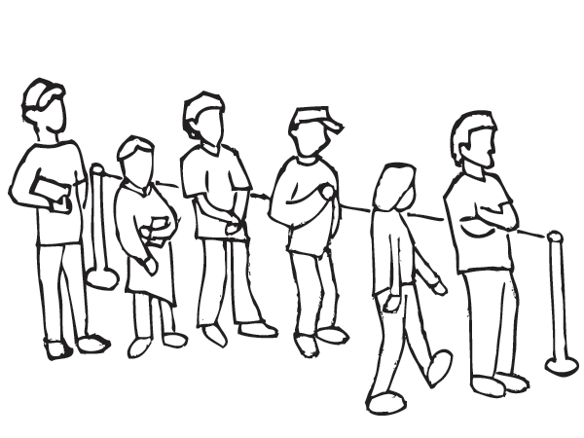
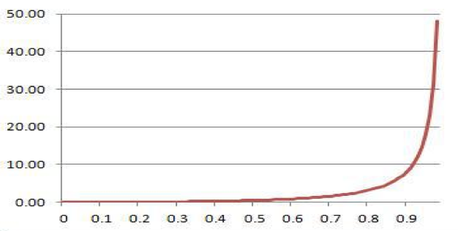
Queueing Theory was the solution
The mathematical study of waiting lines, or queues.
Can quantify relationships between queue size, capacity utilization and cycle times
Queue size (N)
capacity utilization (rho)
Notes:
Fortunately, we’re not going to dive into models or statistics today. You can do that later when you have more than 25 minutes to spend on the topic.

Slide 5
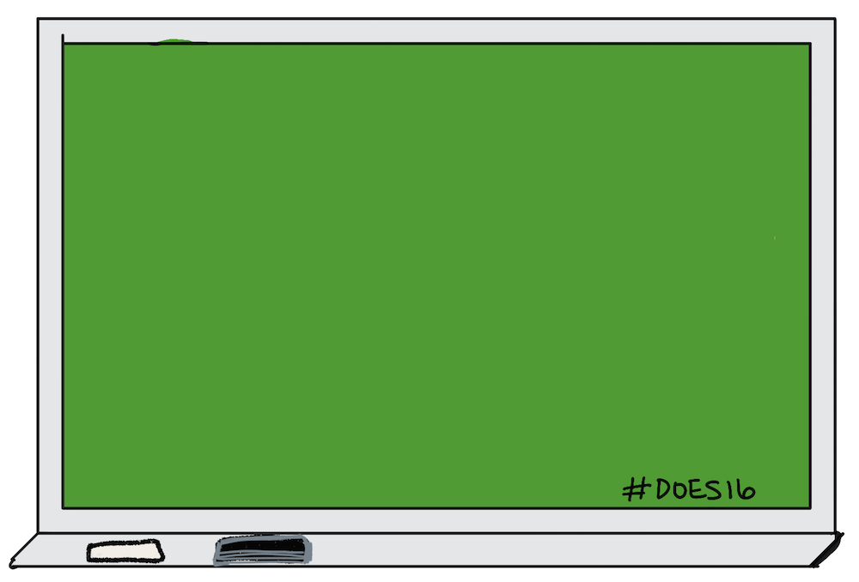
TODAY’S TALK
Why queues matter
Choices we can make about queues
Monitoring your predictability indicators
Notes:
But, we will talk about
how queues matter when we try to have predictable delivery times
Choices that we make about handling our queues that impact our success
and what to monitor to see if we are on the right trajectory

Slide 6
Why Queues Matter

Slide 7


Queues are the waiting work in a system
Notes:
Queues are the waiting work in our system.

Slide 8
Mo’ queue, Mo’ problems
Longer average cycle times
Wider range of cycle times
More mgmt overhead
Reduced motivation & quality
Notes:
The larger our queues, or the amount of work waiting in our system, the more we experience:
(p57 flow book)
remove the increased risk

Slide 9
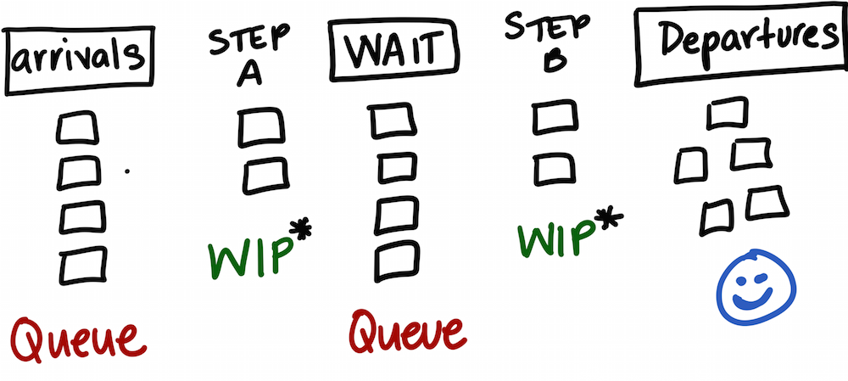
Our workflows are chains of queues

Slide 10
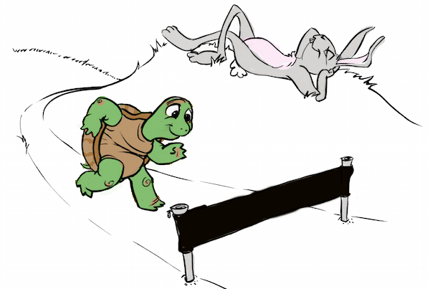
Aesop’s Fable: The Tortoise and the Hare
As interpreted by Don Reinertsen
Finish
Notes:
The hare excelled at adding value quickly, but still lost the race due to periods of inactivity. Eliminating or reducing the periods of inactivity, such as time spent in queues, can be far more important than speeding up activities.
Business units that embraced this approach [queue management for portfolio and product management] reduced their average development times by 30% to 50%. [AMNS96] http://www-bcf.usc.edu/~padler/research/HBR_prod_dev_proc.pdf

Slide 11
To become more predictable…
USUALLY
DONE IN
2 to 200 DAYS!
USUALLY
DONE IN
25 to 35 DAYS!
reduce the range of probable outcomes.
Predictability ≠ fastest UNLESS you can consistently be that fast.
Notes:
That’s why the tortoise beat the hare in the race of predictability. The tortoise went at a nice smooth speed compared to the alternating bursts and stops of the hare.

Slide 12
Choices we can make about queues

Slide 13

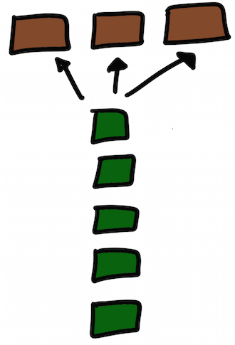
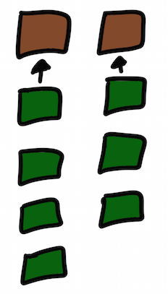
Choice: Use a push system or pull system?
1 queue per server
1 queue multiple servers
Push
System
Pull
System
Which one do you use?
Notes:
Story – make the brown boxes people icons.
Allocation models aka queueing disciplines (from highest variation to least variation)
Over time, a few patterns for processing queues have emerged. One of the places we see them in action most often is at the supermarket checkout area.
One queue per server -- this is your standard checkout lane
Single queue, Multiple server -- you often see a single queue for multiple self-checkout stands
(p.66 in flow book)
So, we can picture this in a supermarket scenario. But, can you picture this in your organization? Which pattern do you see most often?
Many times I see teams choosing a one queue per server approach. Usually how this manifests is with a lot of assigned work queueing up for individuals (either from someone else assigning it to them or them pre-assigning it to themselves) rather than the individual pulling work when they have open capacity.
Our problem is that we have just learned that this approach has the highest variation of all processing patterns. We are choosing the approach with the least predictability! By doing this, we are stealing any potential opportunity for this item to get done earlier by anyone else.
I generally see a couple of reasons why this happens:
The item requires a specialist, so it gets preassigned to that specialist (this blocks potential learning tasks for others that we could cross-train)
People want to work on an item so they assign it to themselves so no one else can pick up the card. “No one else can work on my baby!”
How can we break the cycle?

Slide 14
Wide variation
Slower, but consistent
Push
System
Pull
System
stopped
normal
Notes:
Tell story about how things were very queued up and people were working on so many things they weren’t getting anything done. We unassigned anything that wasn’t priority and definitely unassigned everything that wasn’t started.
We then implemented a system in which a team member, whenever they had capacity to pull a card, pulled the top one that they could accomplish from a prioritized list.

Slide 15

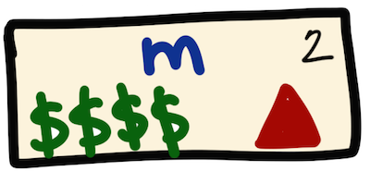
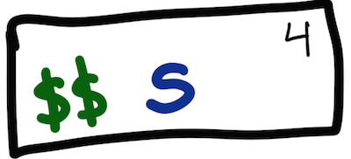

Choice: What factors used to prioritize?
FIFO/S
PRIORITY
Your policy here!
Notes:
story

Slide 16
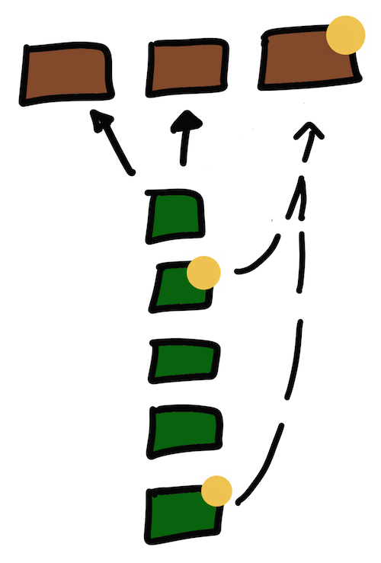
FIFO
Non-FIFO
Less variation.
Wider
variation
Feasible?
Notes:
In both systems, processing time of individual items theoretically stays the same. But, puling things out of order causes other items that were in queue to artificially age, increasing overall cycle times and widening the gap in cycle times between the prioritized items versus the deprioritized items..

Slide 17
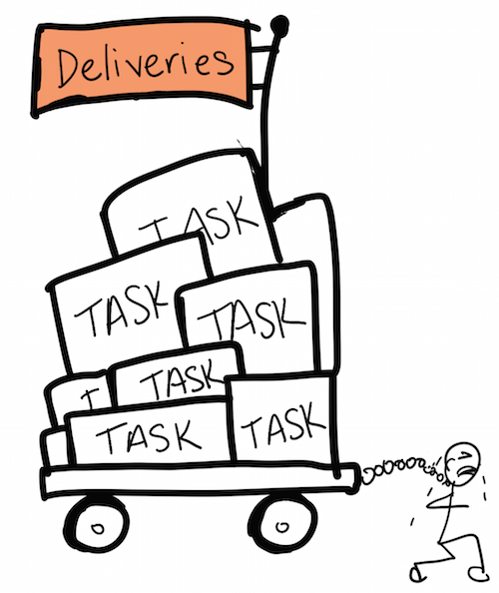

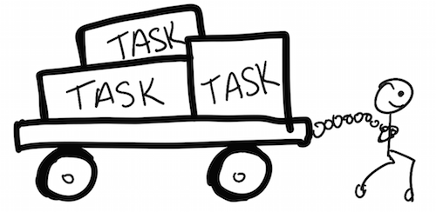
Choice: Deliver large or small batches?
Once a month
Once a week
Notes:
Large batches/queues create longer cycle times and high levels of costly, lost time. Work is piling up to be delivered all at once, unnecessarily inflating cycle times as well as risk from getting feedback later. Historically, large batches were done because the transaction costs of the deployments were so high. The DevOps movement and continuous delivery mechanisms have made this problem much less prevalent. Now, its usually done because people haven’t made the time to improve their deployment pipelines or they are unaware of the costs of big batch deliveries.
Smaller batch sizes will not only result in lower average cycle times, but as there are fewer possible complications, the overall range of cycle times is likely to be narrower as well.

Slide 18
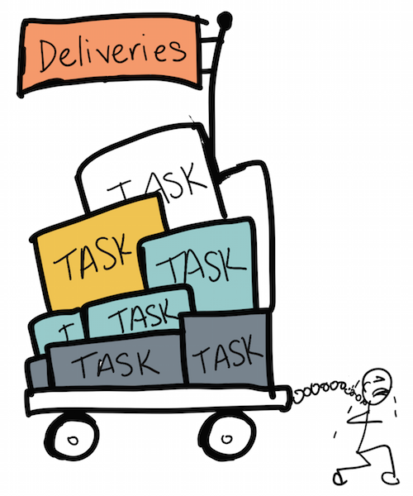

Once a month
Once a week
Wider
variation
Less
variation
Notes:
Holding items that are ready for release artificially inflate cycle times. This causes a wider variation of cycle times and that’s just one of the reasons that big batches cause reduced predictability.

Slide 19
Monitoring your predictability indicators

Slide 20
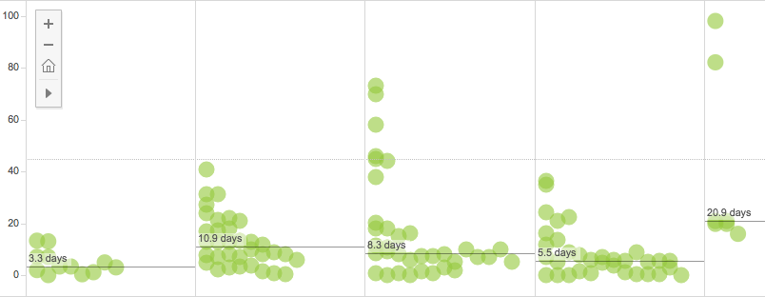
Cycle time ranges: Lagging indicator
July
August
September
October
Nov
Can we reduce the outliers?
Good clustering
95%: 45 days or less
Notes:
This is the cycle time report from my customer success team at LeanKit.
Word clustering throwing red flags for Dominica.

Slide 21
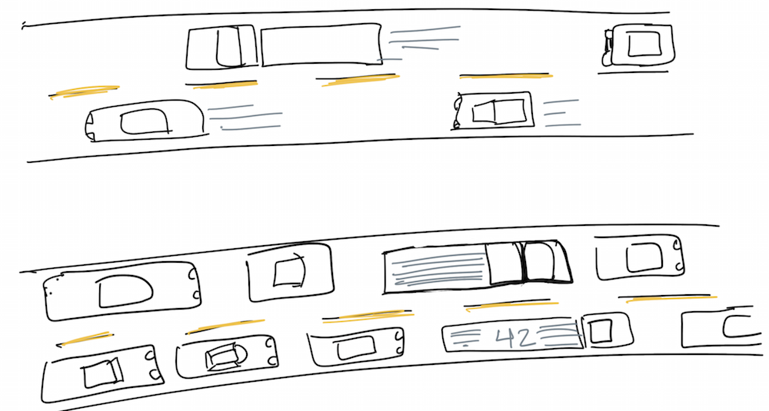
Queue size: a leading indicator
Which lane is going faster?
Notes:
Why focus on queue size?
Other measures like cycle time are lagging indicators. You only know the measurement when the item is complete. If you are watching queue size and you see it double, then you know right away that there will be a proportionate response to the cycle/lead time.
We can’t estimate demand or capacity well, so we can use queue size as the control variable.
When you are at the supermarket, how do you usually decide which checkout queue to enter?
Usually the shortest one (if the jobs in the queue aren’t ginormous -- large carts of groceries).

Slide 22
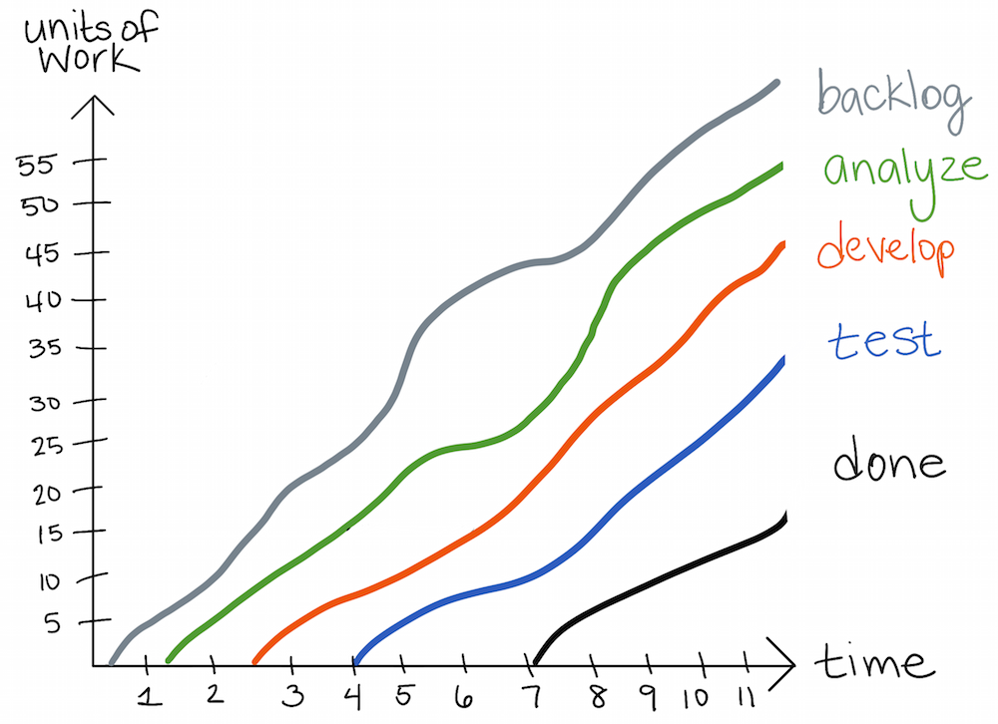
CFD: Demonstrates the relationship
To Do
Work units
Design
1.5
Create
Queue size
Cycle Time
10
2.5
Verify
18
Deliver
Time
Notes:
Instead of CFD, show trend line chart with both queue size and cycle time ranges on them. Look for patterns.

Slide 23
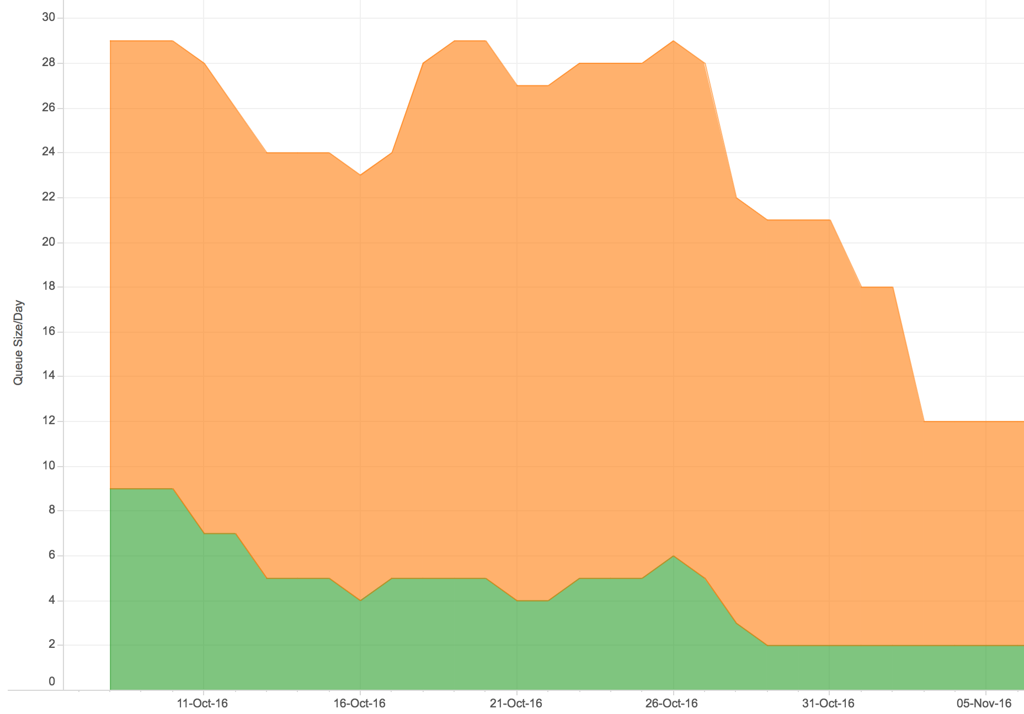
Queue Size: predicting predictability issues
20
Bigger queues lead to longer cycle times, less predictability
Work-In-Process (hidden queues?)
Smaller queues lead to shorter cycle times, more predictability
10
9
Queued work
2
Notes:
Need a better histogram of queue sizes.

Slide 24

Remember, you have control over predictability!
Get baseline measures of queue size/cycle times.
Make informed choices about handling queues.
Monitor queues to anticipate and correct issues before they negatively impact cycle times.
Notes:
You have a lot of control over predictability.
Start with measuring your current queue size and cycle time range.
Make choices that keep queues small and cycle times ranges concise
Monitor queue sizes and cycle times continually to anticipate and correct negative patterns.
Add 2 books here.
Add attribute to David Neal for inspiration for hand-drawn slides.

Slide 25




References and Inspiration
Notes:
Why focus on queue size?
Other measures like cycle time are lagging indicators. You only know the measurement when the item is complete. If you are watching queue size and you see it double, then you know right away that there will be a proportionate response to the cycle/lead time.
We can’t estimate demand or capacity well, so we can use queue size as the control variable.
When you are at the supermarket, how do you usually decide which checkout queue to enter?
Usually the shortest one (if the jobs in the queue aren’t ginormous -- large carts of groceries).

Slide 26
To receive a copy of:
The slide deck for today’s presentation
LeanKit’s 1st Annual Lean Business report
Send an email to: julia@leankit.com
Subject: DOES16

Slide 27
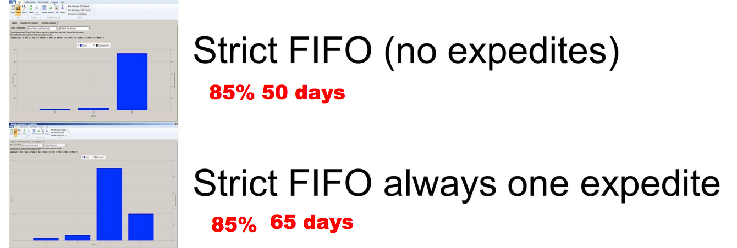
Notes:
Puling things out of order causes other items that were in queue to artificially age, increasing overall cycle times.
http://www.ontheagilepath.net/2015/04/unleash-predictability-by-using-actionable-agile-metrics-6-key-learnings-from-daniel-s-vacantis-awesome-book.html

